Slide 1
Subject: Biology for Engineers
Unit 1: Biomolecules and Enzymes
Topic: Enzymatic Processes in Industrial Production & its application
Question:
Select any one enzyme that is used in an industrial process and explain how it contributes to the production of a specific industrial product.
~ByMalay Thakkar
(D-48) Roll No :16010125263

Slide 2

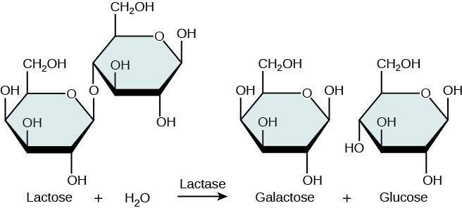

Enzyme: Lactase(β-galactosidase) Role: Hydrolyzes lactose(milk sugar) into glucose and galactose,which are easily digestable Industrial use: DAIRY INDUSTRY production of Lactose-Free dairy products
Process
1.Milk Selection: Regular cow's milk is first collected and pasteurized.
2.Addition of Lactase: The enzyme lactase (ẞ-galactosidase) is added to the milk.
3.Enzymatic Hydrolysis: Under controlled conditions (around 37-50°C and neutral pH), lactase breaks down lactose - the natural sugar in milk - into its simpler sugars, glucose and galactose.
4.Final Product: The result is lactose-free milk that tastes slightly sweeter (due to glucose and galactose being sweeter than lactose) but retains the same nutritional profile as regular milk.
5. Packaging and Distribution: The treated milk is packaged and sold as lactose free milk,
ice cream, yogurt, and other dairv products.

Slide 3

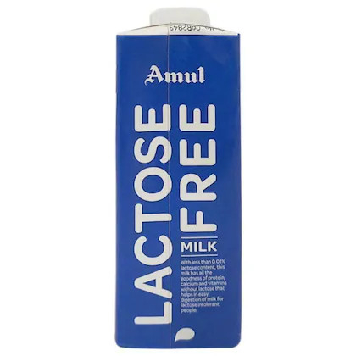

Product: Lactose-Free Milk 1)Easier to digest for lactose-intolerant individuals 2)as per survey,up to 70% of world’s population is LACTOSE INTOLERANT 3)Computational method anaylze lactase gene structure,protein structure and 3D shape 4)models can stimulate lactase interacts with lactose and behaviour with change in temp.
Amul Lactose-Free Milk :
Amul (Gujarat Co-operative Milk Marketing Federation), one of India's largest dairy cooperatives.
Product: Amul Lactose-Free Milk . The process involves adding lactase enzyme to ultra-heat treated (UHT) milk with high precision to hydrolyze lactose into glucose and galactose. Afterwards, the milk is packaged aseptically to retain quality
Why it works: Glucose and galactose are easier to digest for people with lactose intolerance
The final product maintains the nutritional benefits of regular milk (protein, calcium, vitamins), minus the lactose

Slide 4
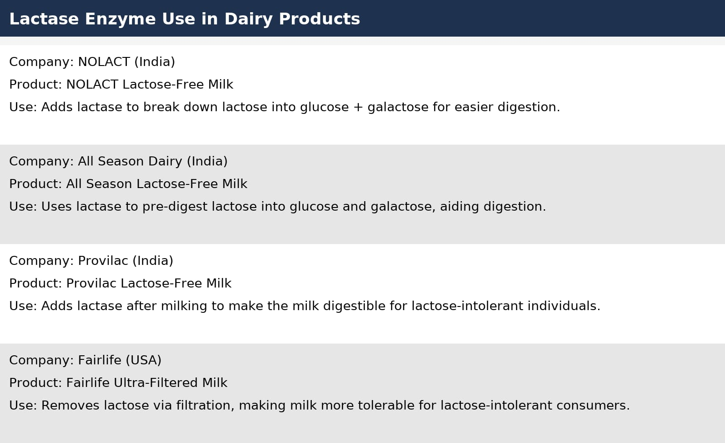
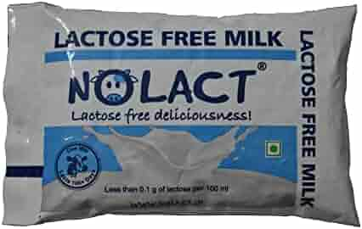

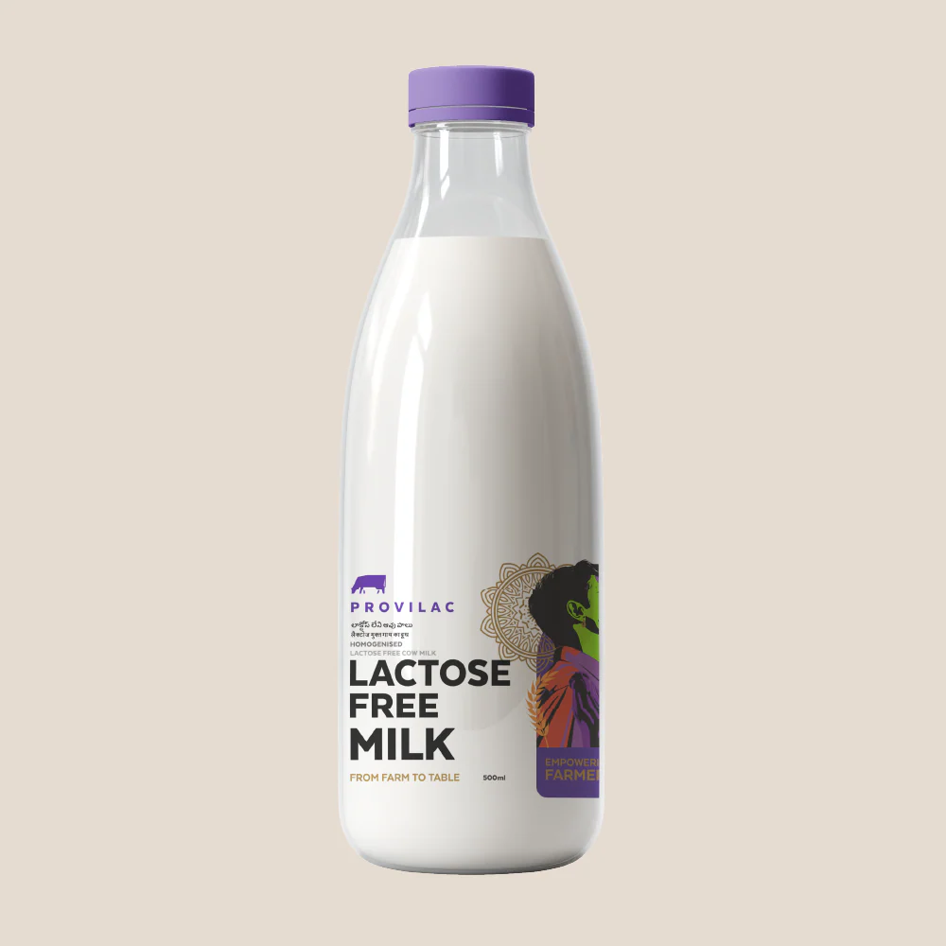


Slide 5

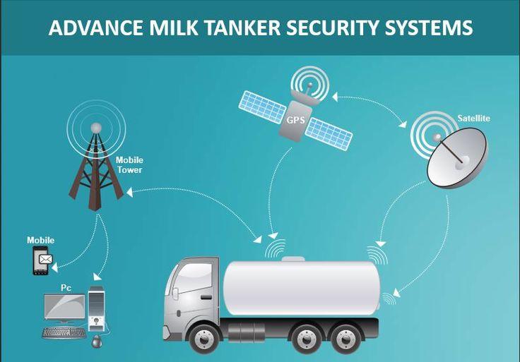
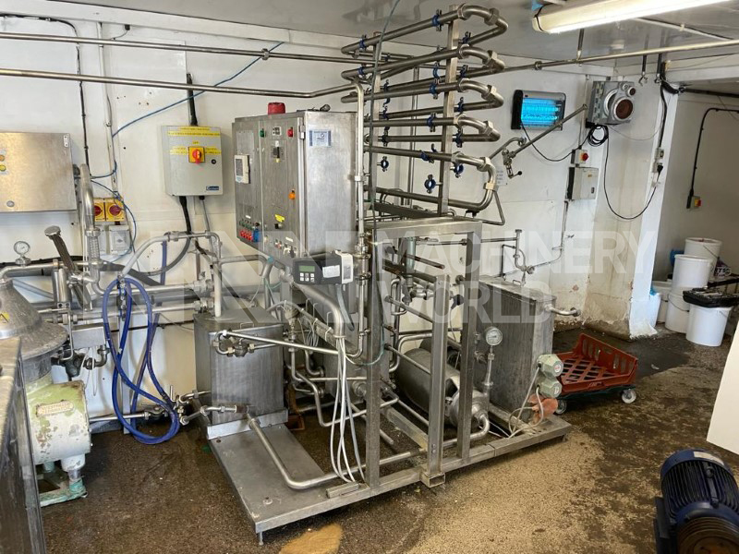
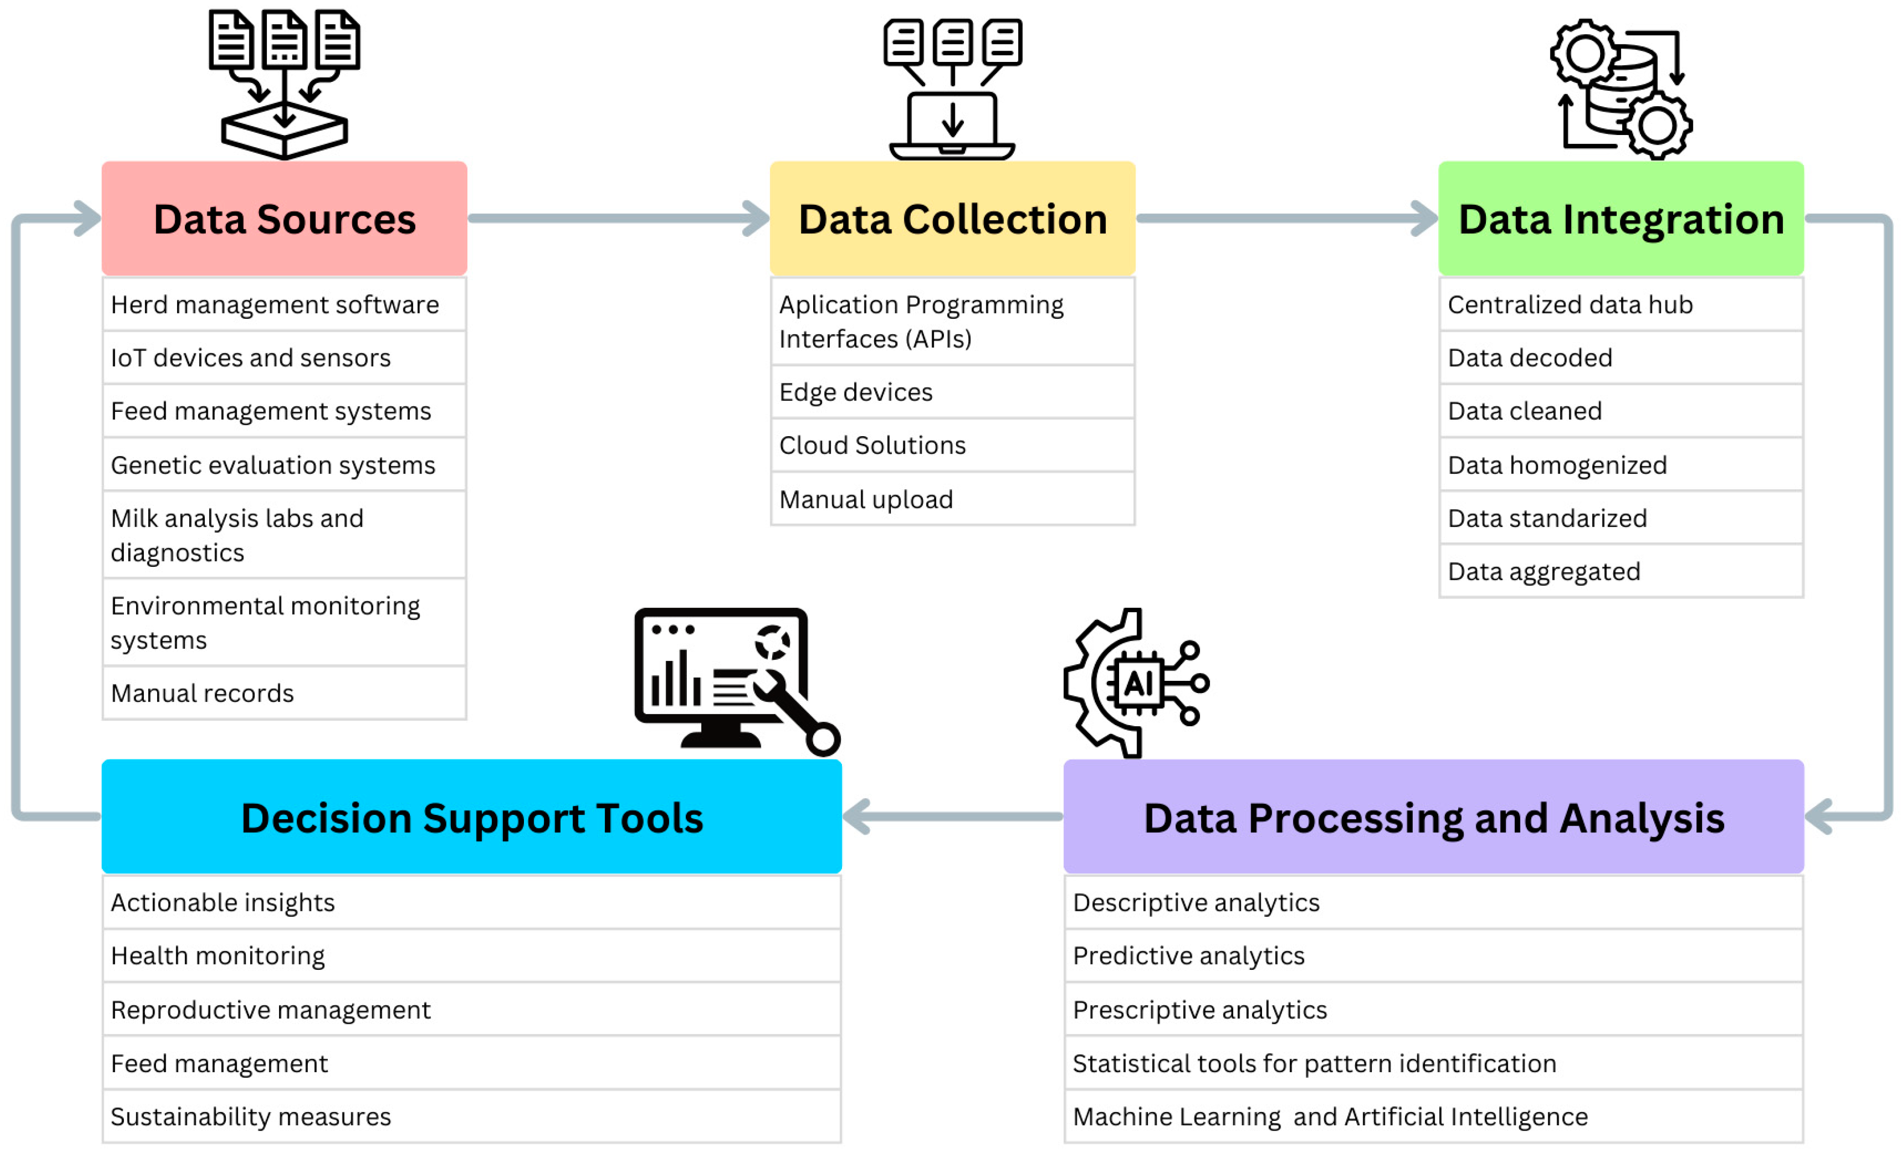
Role of Computer Engineering in Dairy Industry: 1)Automation: Efficiency can be maximized using Robot Automation and AI 2)Data Analytics: To assure quality,predicts demand and waste reduction 3)Supply Chain:Purity is assured as products can be tracked from farm to consumer 4)Precision Farming:Sensors track cow health, yield and feeding.

Slide 6
REFERENCES:
https://amul.com/index.php
https://www.wikipedia.org/
https://louis.pressbooks.pub/app/uploads/sites/50/2022/04/image1-6.jpeg
National institutes of health(nih)
5)https://5.imimg.com/data5/SELLER/Default/2023/1/LB/HO/VK/3404135/cow-monitoring-technology-for-heat-health-detection.jpg
6) https://www.machineryworld.com/wp-content/uploads/2021/07/WhatsApp-Image-2021-07-02-at-10.46.47-3.jpg
7) https://nolact.in/
8) https://provilac.in/
9) https://allseasondairy.com/
10) https://fairlife.com/

